Slide 1

Module 8: Portfolio Project Resource Management Analysis for COVID-19
Wilson H Chan
Colorado State University Global
MIS581: Capstone – business intelligence and data analytics
April 9th, 2023

Slide 2
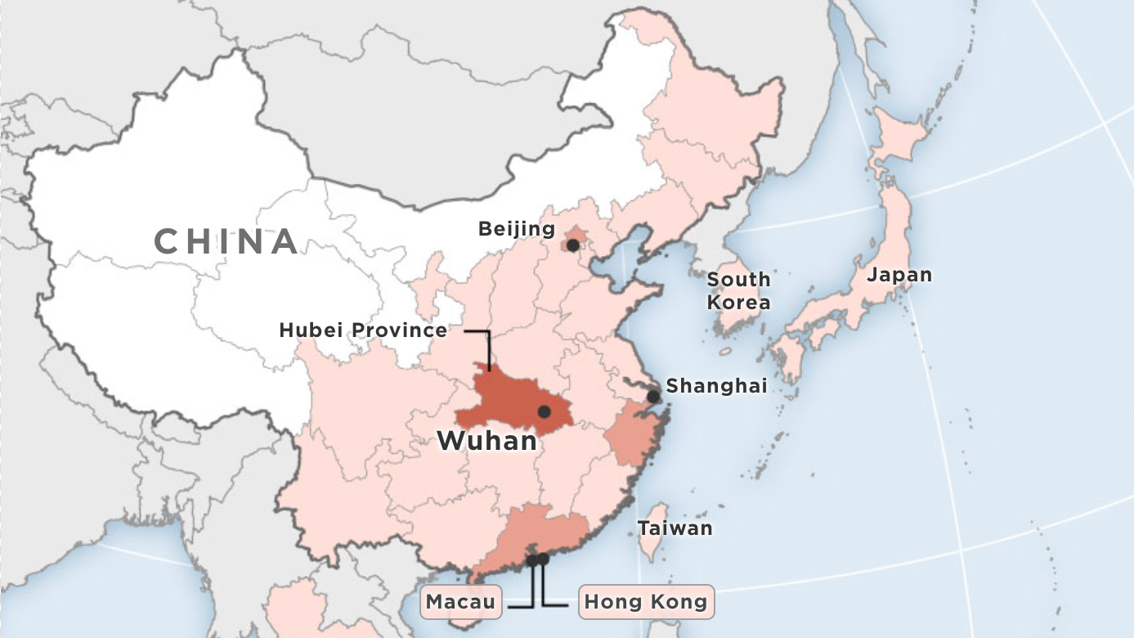

Introduction on COVID-19
COVID-19 (Coronavirus) is a highly infectious respiratory illness
First identified in Wuhan, China in December 2019
Symptoms include
Fever
Cough
Fatigue
Shortness of Breath
Loss of taste or smell
Body aches

Slide 3
Project Goals and Objectives
Determine how resources are managed within the US in response to the COVID-19 pandemic
Research question
How is the US able to properly manage resources to combat the COVID-19 pandemic?
Focuses mainly on the following resources
Hospital Bed Space Capacity
Vaccine Distribution
Scope: Study only applies to the top 4 populated States in the US (California, Florida, New York, Texas)
Top 4 Populated States in the US
State | State Initials | Population
California | CA | 40,223,504
Texas | TX | 30,345,487
Florida | FL | 22,359,251
New York | NY | 20,448,194

Slide 4

The Datasets - Methodology
Healthdata.gov
Repository of health related data
“COVID-19 Reported Patient Impact and Hospital Capacity by Facility”
Inpatient_beds_used_7_day_sum
Inpatient_beds_7_day_sum
total_adult_patients_hospitalized_confirmed_covid_7_day_sum
“COVID-19 Vaccinations in the United States, County”
Series_Completed_Yes
Census2019

Slide 5
Hypothesis 1
Is inpatient bed usage rate (IBUR) is statistically different among the top 4 populated states?
H₀ : There is no significant difference in average IBUR between the top 4 populated states (CA, FL, NY, TX)
H_{a}: The average IBUR between the top 4 populated states are not equal.
IBUR calculated using the formula:
IBUR = Inpatient_beds_used_7_day_sum ÷ Inpatient_beds_7_day_sum
One-way analysis of variance (ANOVA) used for hypothesis testing

Slide 6
Hypothesis 2
Is there a statistical difference in the number of hospitalized adult COVID patients within top 4 populated states?
H₀ : There is no significant difference in the average number of hospitalized adult COVID patients between the top 4 populated states (CA, FL, NY, TX)
H_{a}: The average number of hospitalized adult COVID patients between the top 4 populated states are not equal.
Analyze variable:
total_adult_patients_hospitalized_confirmed_covid_7_day_sum
One-way analysis of variance (ANOVA) used for hypothesis testing

Slide 7
Hypothesis 3
Is there a statistical difference in vaccination rate among the top 4 populated states?
H₀ : There is no significant difference in the average vaccination rate between the top 4 populated states (CA, FL, NY, TX)
H_{a}: The average vaccination rates between the top 4 populated states are not equal.
Vaccination Rate calculated using the formula:
Vaccination rate = Series_Complete_Yes ÷ Census2019
One-way analysis of variance (ANOVA) used for hypothesis testing

Slide 8


Limitations & Ethical Considerations
Data precedes accurate identification of COVID-19 infections
Demographics are not represented by the datasets
Both datasets contain missing values
Data cleaning methods used to adjust data errors
Both datasets include patient information
Patient privacy is maintained however data collection methods are unknown

Slide 9
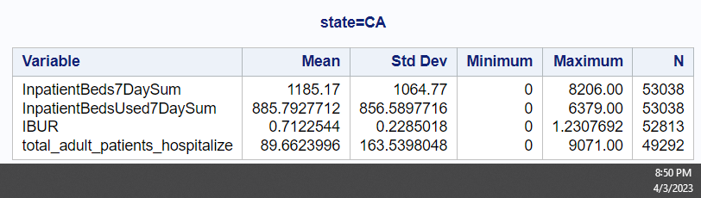
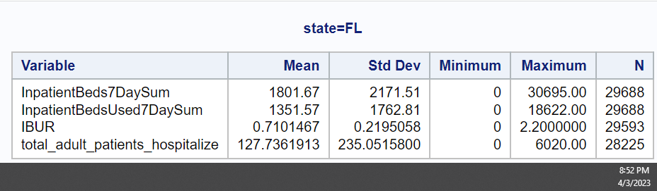
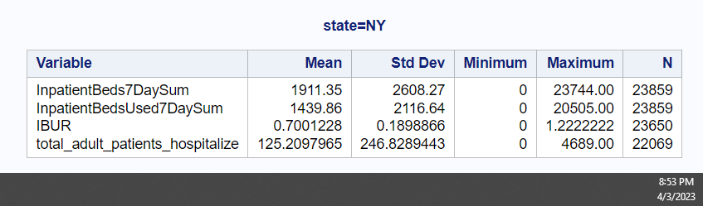
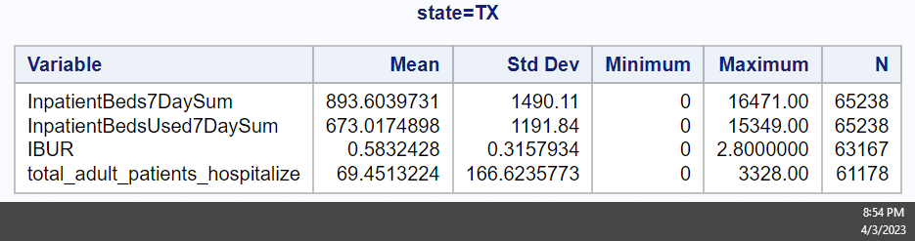
Hospital Capacity Dataset Summary Statistics
Average IBUR for CA, FL, and NY are relatively similar at around 70%
TX has the lowest IBUR among the largest populated states
FL and NY have the highest average number of hospitalized adults at about 127 adults per hospital
Figure 1: CA Summary Statistics Figure 2: FL Summary Statistics
Figure 3: NY Summary Statistics Figure 4: TX Summary Statistics
Notes:
CA 40 million, TX 30 million, FL 23 million, NY 20 million

Slide 10
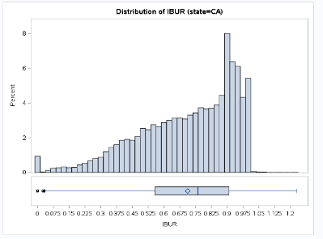
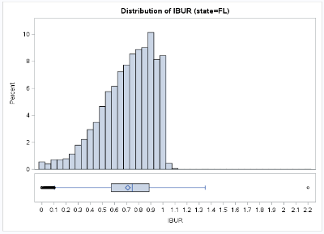
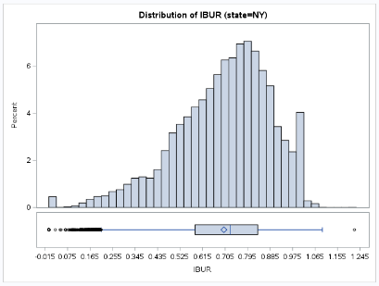
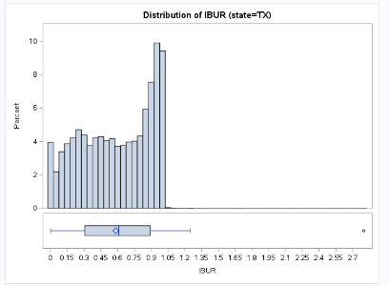
IBUR Distribution
Figure 5: Distribution of IBUR by State
All IBUR distributions for each state are skewed left
High bed usage rate over the course of the pandemic
Centered around the 70% mark

Slide 11
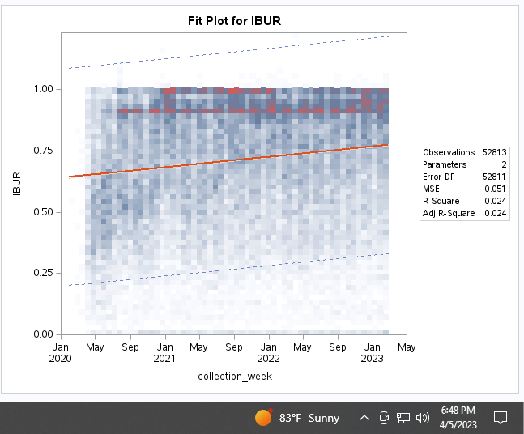
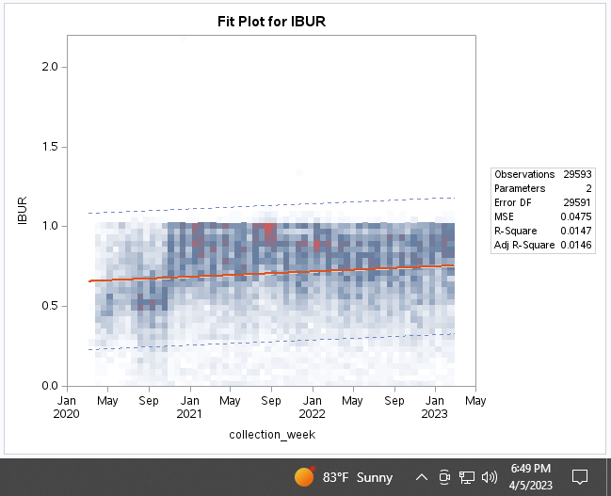
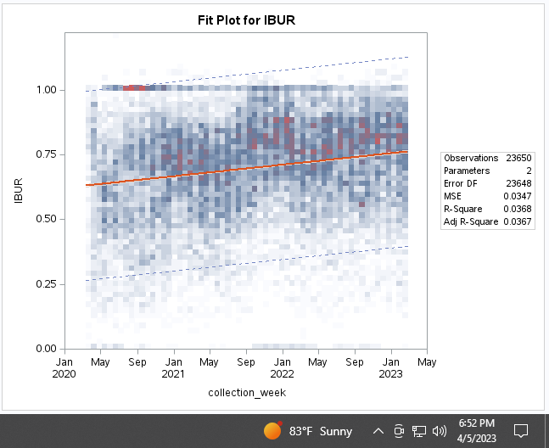
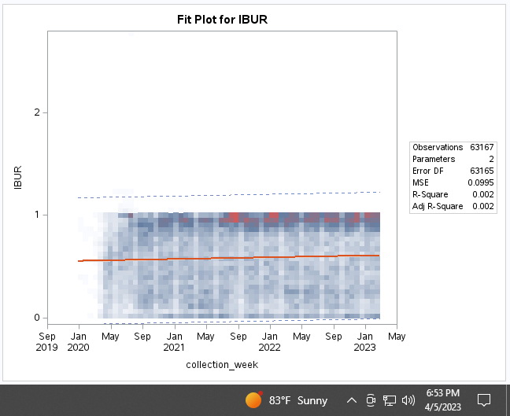
IBUR Time Regression Analysis
Figure 6: CA’s IBUR Time Regression Analysis
Figure 7: FL’s IBUR Time Regression Analysis
IBUR steadily increased over the course of the pandemic
NY has the greatest rate of increasing IBUR with an increase of 0.000122 per week
Figure 8: NY’s IBUR Time Regression Analysis
Figure 9: TX’s IBUR Time Regression Analysis

Slide 12
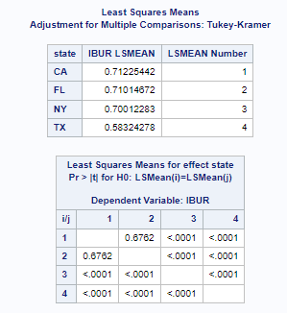
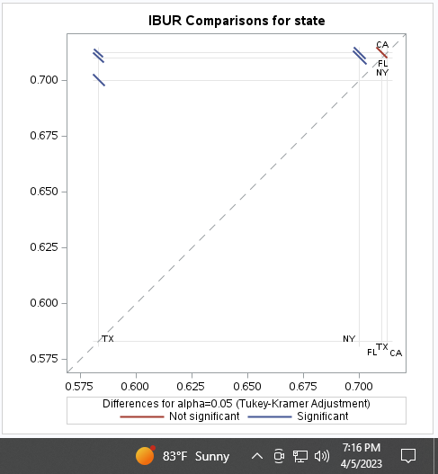
IBUR ANOVA
Figure 10: IBUR ANOVA Comparison Results
Table of The Least Square Means
p-values where p-values less than 0.05 are significant
Non-significant difference appears between CA and FL
Significant difference between other states
1st Hypothesis: Is inpatient bed usage rate (IBUR) is statistically different among the top 4 populated states?
Reject the null hypothesis

Slide 13
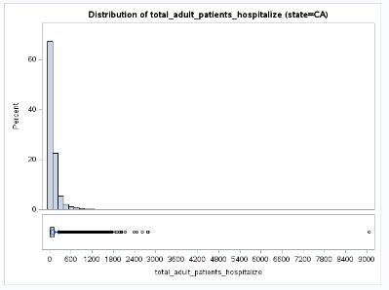
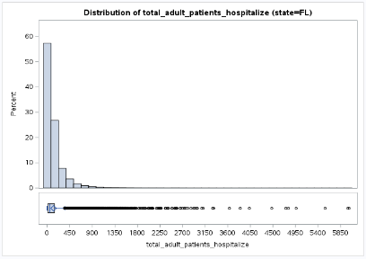
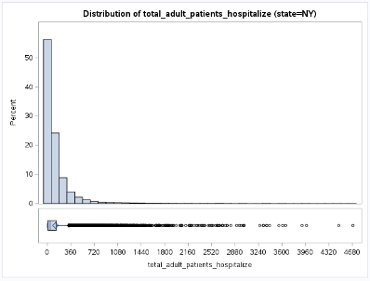
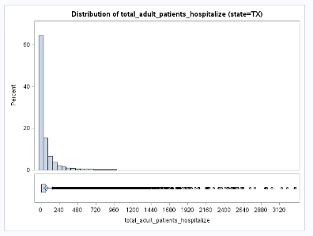
Total Hospitalized Adult COVID Patients Distribution
Figure 11: Distribution of Total Hospitalized Adult COVID Patients Per State
Total number of hospitalized Adult COVID patients for each state are skewed left

Slide 14
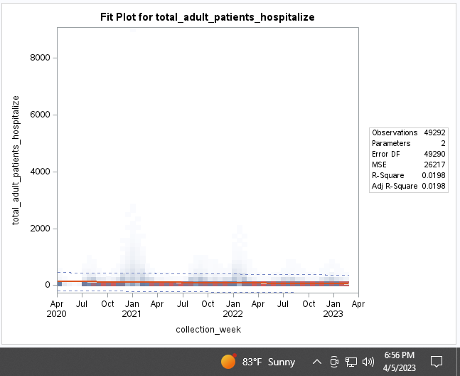
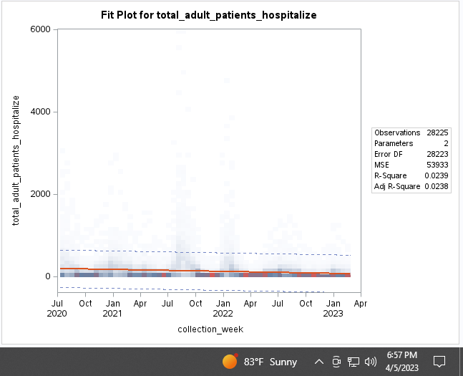
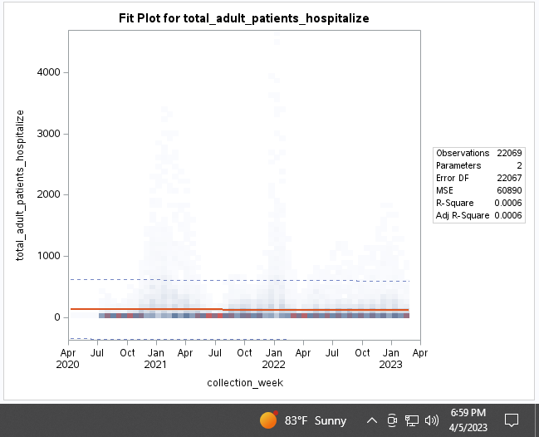
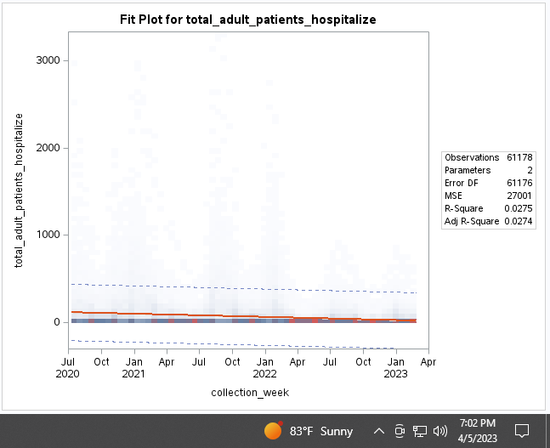
Total Hospitalized Adult COVID Patients Time Regression Analysis
Figure 12: CA’s Hospitalized Covid Cases
Regression Analysis
Figure 13: FL’s Hospitalized Covid Cases
Regression Analysis
Total number of hospitalized adult patients due to COVID-19 steadily decreased over time for each state
NY has the slowest rate of decreasing number of hospitalized COVID-19 patients at -0.02231 patients per week
Figure 14: NY’s Hospitalized Covid Cases
Regression Analysis
Figure 15: TX’s Hospitalized Covid Cases
Regression Analysis

Slide 15
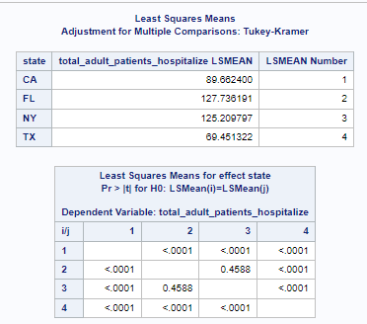
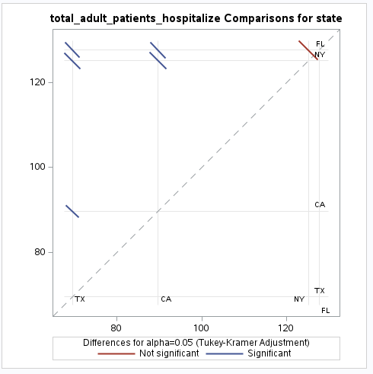
Total Hospitalized Adult COVID Patients ANOVA
Table of The Least Square Means
p-values where p-values less than 0.05 are significant
Non-significant difference appears between FL and NY
Significant difference between other states
2nd Hypothesis: Is there a statistical difference in the number of hospitalized adult COVID patients within top 4 populated states?
Reject the null hypothesis
Figure 16: Total Hospitalized Adult COVID Patients ANOVA Comparison Results

Slide 16
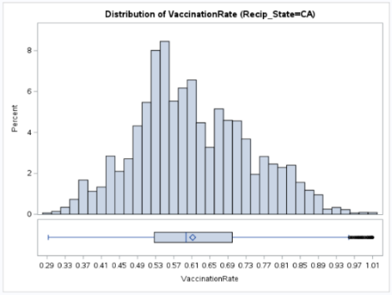
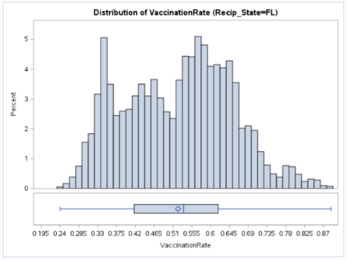
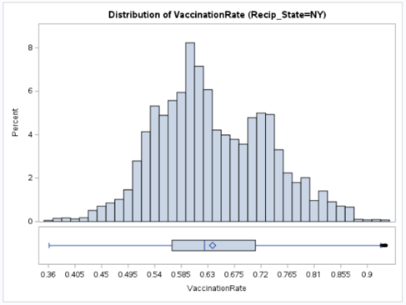
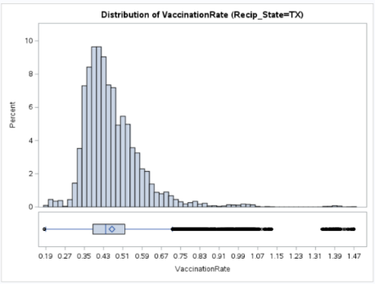
Vaccination Rate Distribution
Figure 17: Distribution of Vaccination Rate per State
CA, FL, and NY seem to be somewhat bimodal
TX is skewed slightly to the right with many outliers.

Slide 17
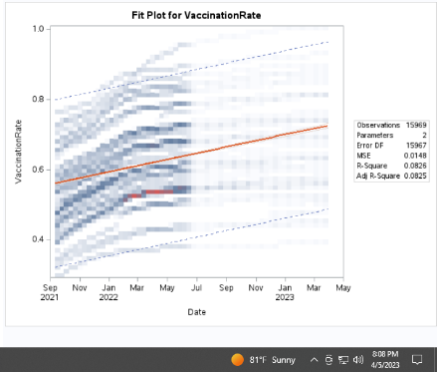
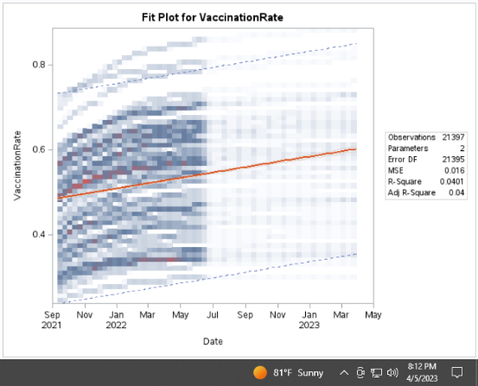
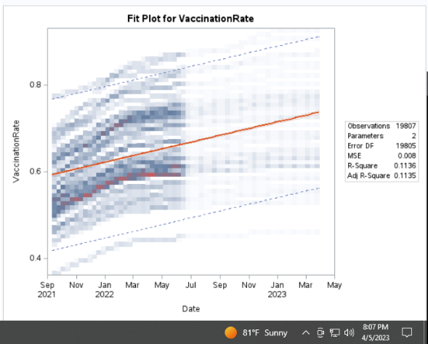
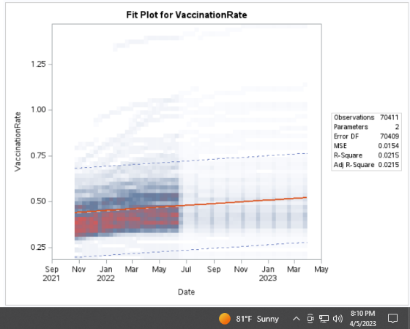
Vaccination Rate Time Regression Analysis
Figure 18: CA’s Vaccination Rate Time Regression
Figure 19: FL’s Vaccination Rate Time Regression
Vaccination rate steadily increased over time for each state
TX has the lowest rate of vaccination improvement at 0.000156 per week
Figure 20: NY’s Vaccination Rate Time Regression
Figure 21: Vaccination Rate Time Regression

Slide 18
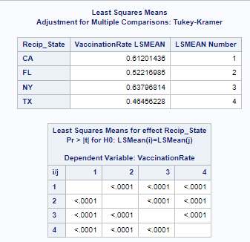
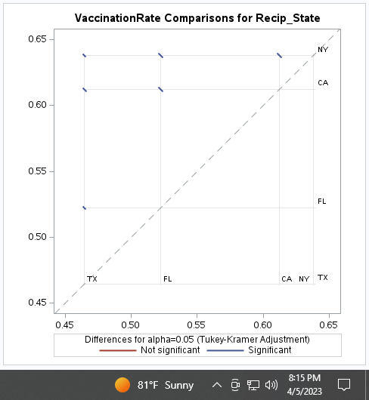
Vaccination Rate ANOVA
Table of The Least Square Means
p-values where p-values less than 0.05 are significant
Significant differences between all states
3rd Hypothesis: Is there a statistical difference in vaccination rate among the top 4 populated states?
Reject the null hypothesis
Figure 22: Vaccination Rate ANOVA Comparison Results

Slide 19
Conclusions
Hypotheses
Is inpatient bed usage rate (IBUR) is statistically different among the top 4 populated states?
Significant differences found between some states
CA and FL have the highest IBUR
Is there a statistical difference in the number of hospitalized adult COVID patients within top 4 populated states?
Significant differences found between some states
FL and NY have the highest number of hospitalized COVID patients
Is there a statistical difference in vaccination rate among the top 4 populated states?
Significant differences found between all states
TX has the lowest vaccination rate

Slide 20
Recommendations
US should provide CA and NY with additional resources to increase bed space capacity to lower bed usage rate
Investigate why CA and NY have the highest IBUR using other variables contained in the same dataset
FL and NY have the highest number of hospitalized COVID patients
Investigate other factors such as population density and demographics
US should supply TX with vaccination programs to help improve their vaccination rate

Slide 21
References
Alkarkhi, A. (2021). 1 - Introduction to statistical hypothesis testing, Applications of Hypothesis Testing for Environmental Science, Elsevier, Pages 1-12, ISBN 9780128243015, https://doi.org/10.1016/B978-0-12-824301-5.00006-X.
Brüggemann, S., Chan, T., Wardi, G., Mandel, J., Fontanesi, J., & Bitmead, R. R. (2021). Decision support tool for hospital resource allocation during the COVID-19 pandemic. Informatics in Medicine Unlocked, 24. https://doi.org/10.1016/j.imu.2021.100618
Centers for Disease Control and Prevention (2023) COVID-19 Vaccinations in the United States, County [Dataset]. https://healthdata.gov/dataset/COVID-19-Vaccinations-in-the-United-States-County/ipdn-uaih
Darity, W. (2008). Time Series Regression. International Encyclopedia of the Social Sciences, 2nd ed., Vol. 8, p. 371-372. Macmillan Reference USA.
Jensen, A. (2020). COVID-19: Overview, Economic Implications and Federal Response. SNOVA.
Scheff, S. (2016) Chapter 6 - One-Way Analysis of Variance, Fundamental Statistical Principles for the Neurobiologist, Academic Press, Pages 97-133, ISBN 9780128047538, https://doi.org/10.1016/B978-0-12-804753-8.00006-3.
Shukla, S., Fressin, F., Un, M., Coetzer, H., & Chaguturu, S. K. (2022). Optimizing vaccine distribution via mobile clinics: a case study on COVID-19 vaccine distribution to long-term care facilities. Vaccine, 40(5), 734–741. https://doi.org/10.1016/j.vaccine.2021.12.049
Singh, S., Ambooken, G. C., Setlur, R., Paul, S. K., Kanitkar, M., Singh Bhatia, S., & Singh Kanwar, R. (2021). Challenges faced in establishing a dedicated 250 bed COVID-19 intensive care unit in a temporary structure. Trends in Anaesthesia and Critical Care, 36, 9–16. https://doi.org/10.1016/j.tacc.2020.10.006
US Department of Health and Human Services (2023) COVID-19 Reported Patient Impact and Hospital Capacity by Facility [Dataset]. https://healthdata.gov/Hospital/COVID-19-Reported-Patient-Impact-and-Hospital-Capa/anag-cw7u

Slide 22
Thank you!

